Slide 1


Travel Destination Guide for Planning Adventure
J. Krishna Chaithanya 2520040049
Cluster: 4

Slide 2
Abstarct:
Planning adventure trips can be difficult due to the large number of destinations, activities, and travel options available.
Travelers often need to search through multiple websites to find information about destinations, weather, accommodation, transportation, and activities.
This process can be time-consuming and confusing for users.
The Travel Destination Guide for Planning Adventures is proposed to simplify trip planning.
The platform helps users discover adventure destinations and explore different activities. It provides important details such as destination information, weather conditions, and travel tips.
The system also includes tools to help users plan and organize their trips efficiently. Overall, the platform aims to make adventure trip planning easier, safer, and more convenient for travelers.

Slide 3

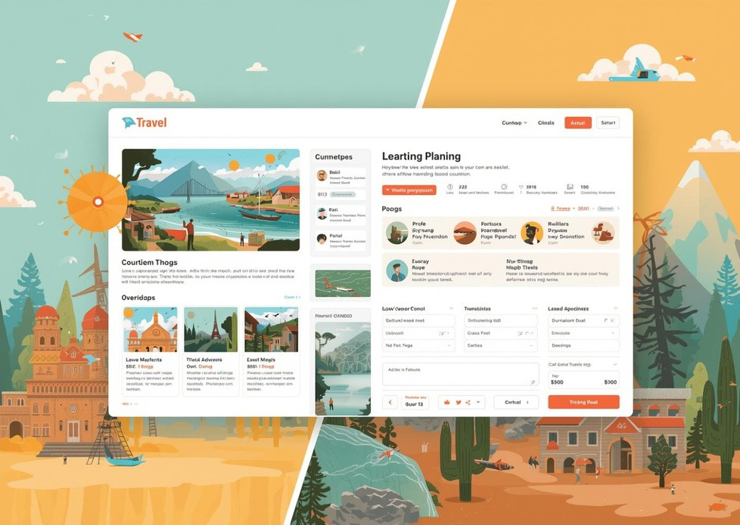
Existing Travel Planning Solutions
Current Platforms Used by Travelers
Travel websites and blogs provide information about destinations and travel experiences.
Online booking platforms allow users to book flights, hotels, and adventure activities.
Navigation and map services help travelers find destinations and travel routes. Social media platforms allow travelers to share reviews, photos, and recommendations.
Limitations of Existing Solutions
Information is scattered across multiple platforms, making planning time- consuming.
Most platforms do not focus specifically on adventure trip planning. Lack of personalized recommendations based on user interests and preferences.
Difficult to find all adventure activities and travel information in one place.

Slide 4
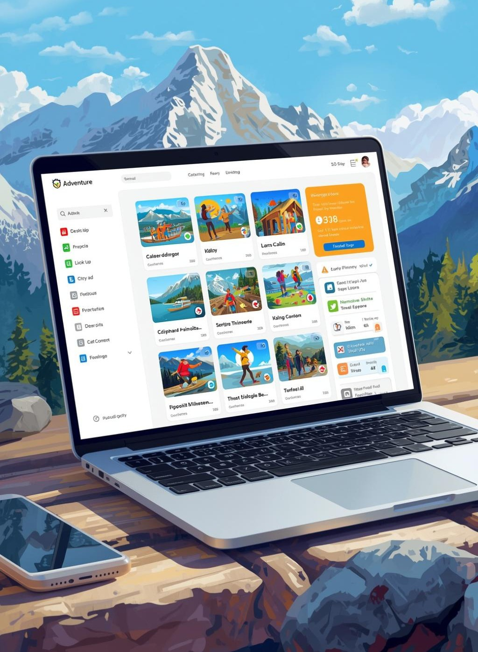
Introducing Our Adventure Platform
Your one-stop solution for planning
Key features of the system include: Adventure Destination Discovery
Users can explore various adventure destinations such as mountains, beaches, forests, and deserts.
Activity-Based Search
Travelers can search for activities like trekking, hiking, scuba diving, paragliding, camping, and more.
avel plans, track destinations, and organize adventure activities. User Reviews and Ratings
Travelers can read experiences and recommendations from other users.
Interactive Maps
Helps users locate adventure spots and nearby facilities.

Slide 5

Objectives
Explore diverse terrains and experiences
To provide detailed information about adventure destinations such as location, activities, and travel tips.
To allow users to search and explore different adventure activities like trekking, camping, scuba diving, and hiking. To provide weather information and best time to visit for each destination.
To include user reviews and ratings to help travelers make better decisions.
To integrate maps and navigation for locating adventure destinations easily.
To create a centralized platform where all adventure travel information is available in one place.

Slide 6
CO’s Attainment
CO1 – Internet Fundamentals, HTML & Introductory CSS Styling

Slide 7
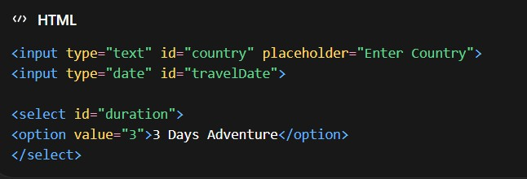
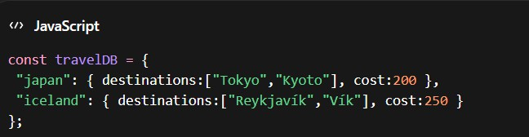



CO3 – JavaScript Programming Essentials
CO2 – HTML Forms, Semantic Tags & CSS Layouts

Slide 8



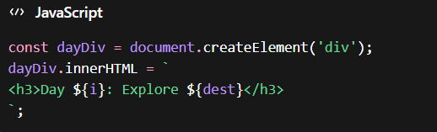

CO5 – Advanced Web Development Concepts
CO4 – JavaScript Interactivity, DOM & Events

Slide 9

Project Screen Shots

Slide 10
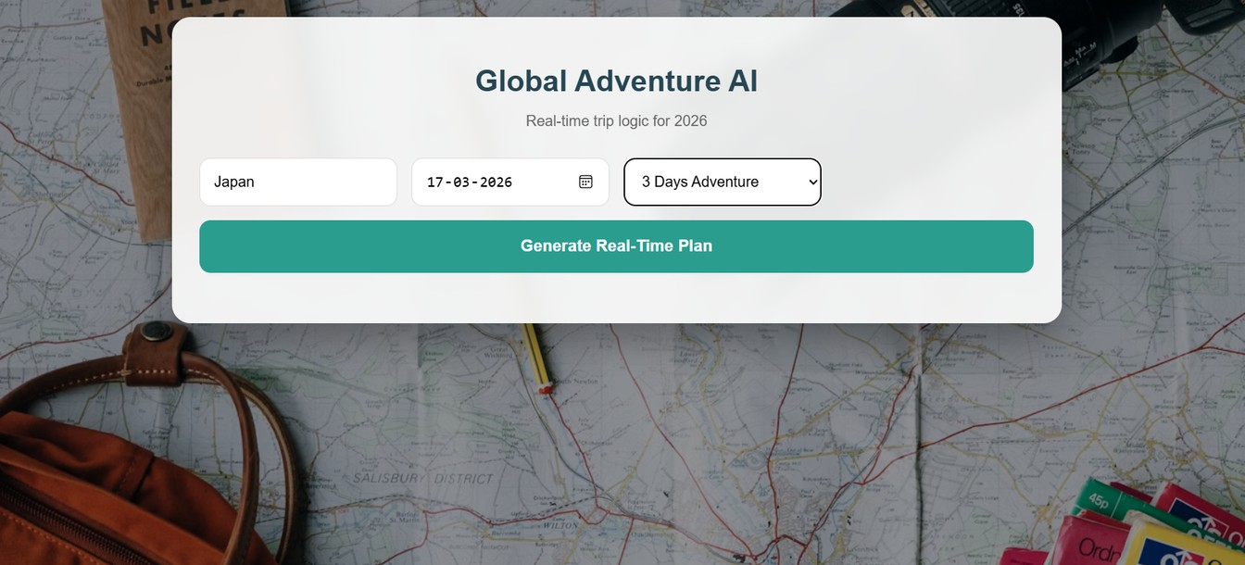
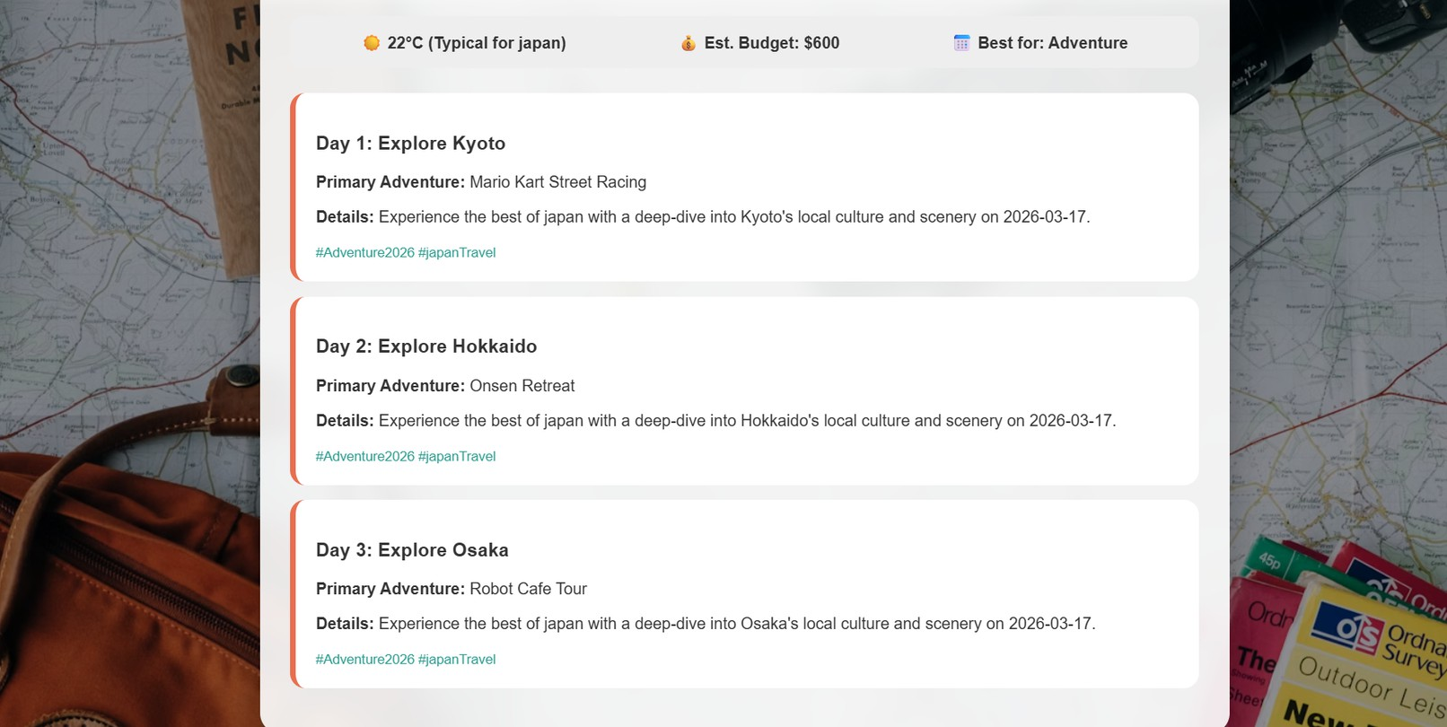

Slide 11
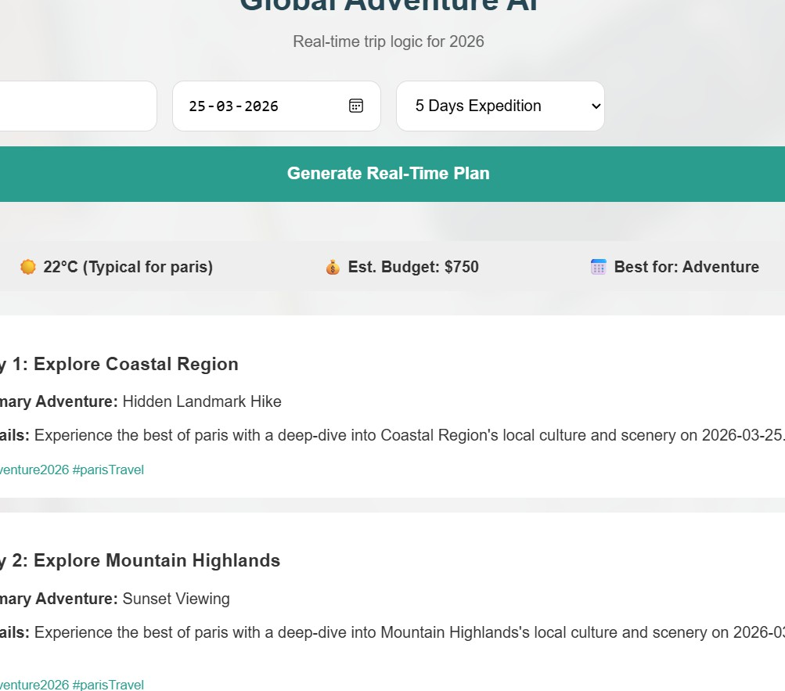
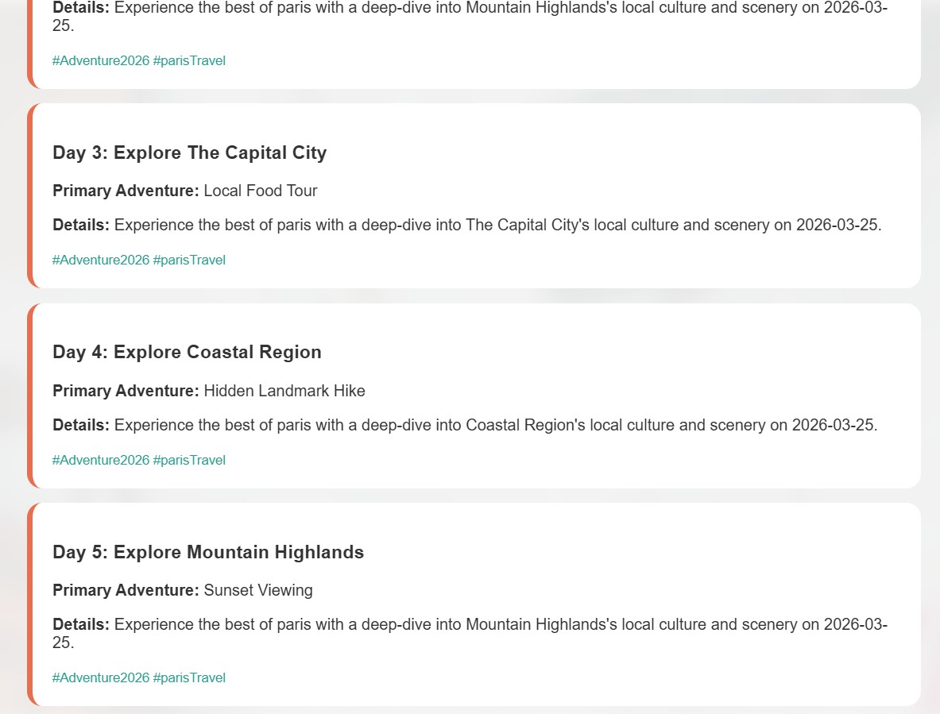

Slide 12
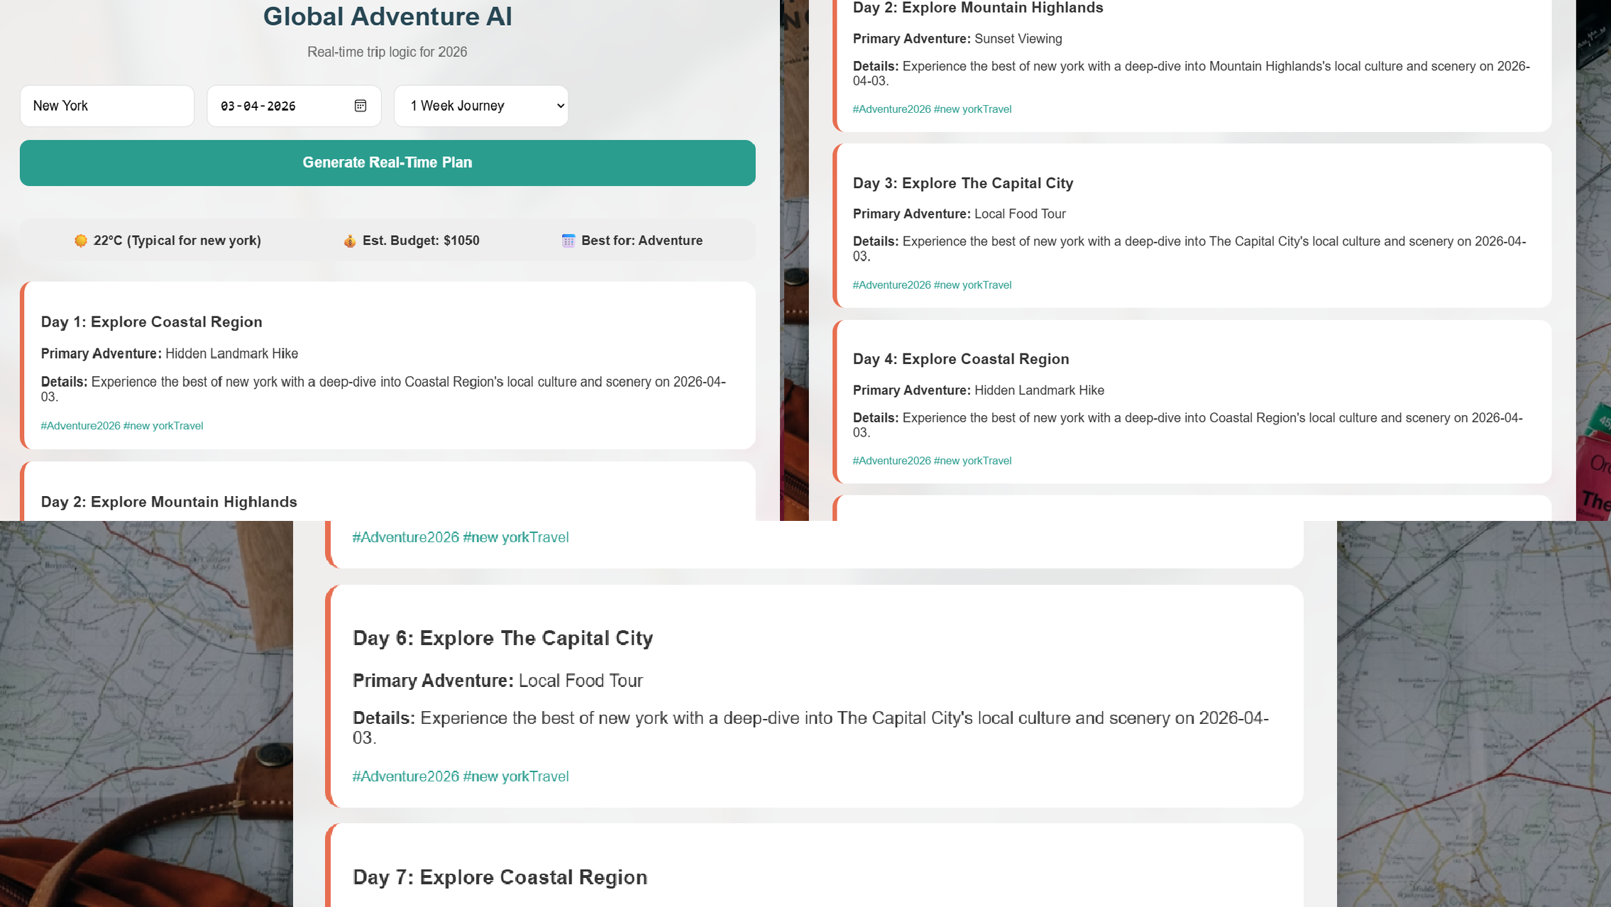

Slide 13
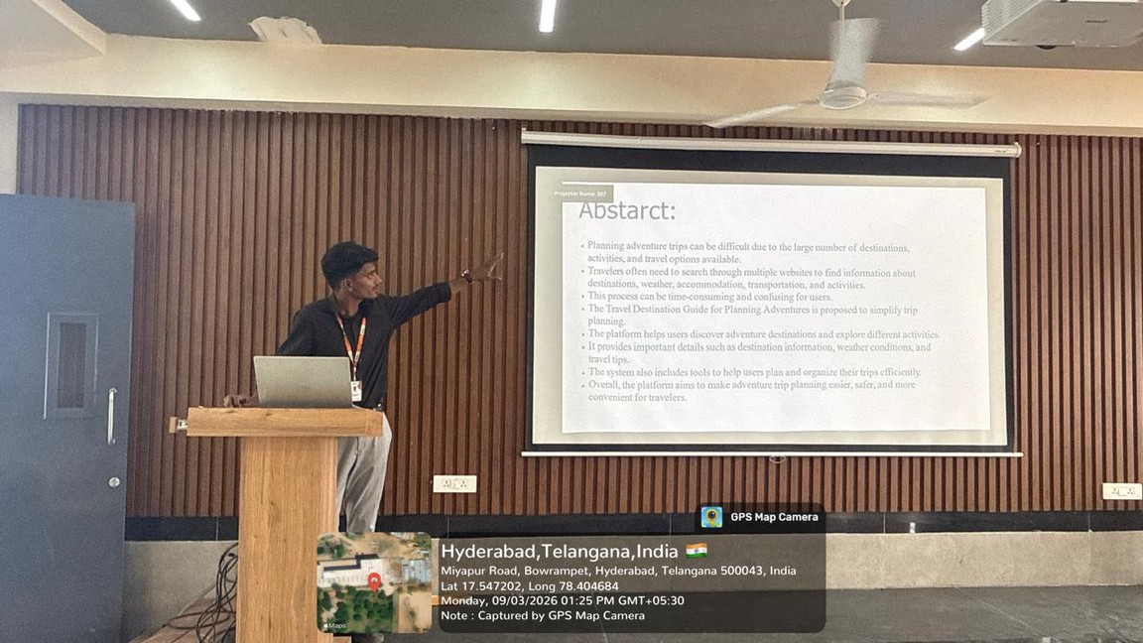
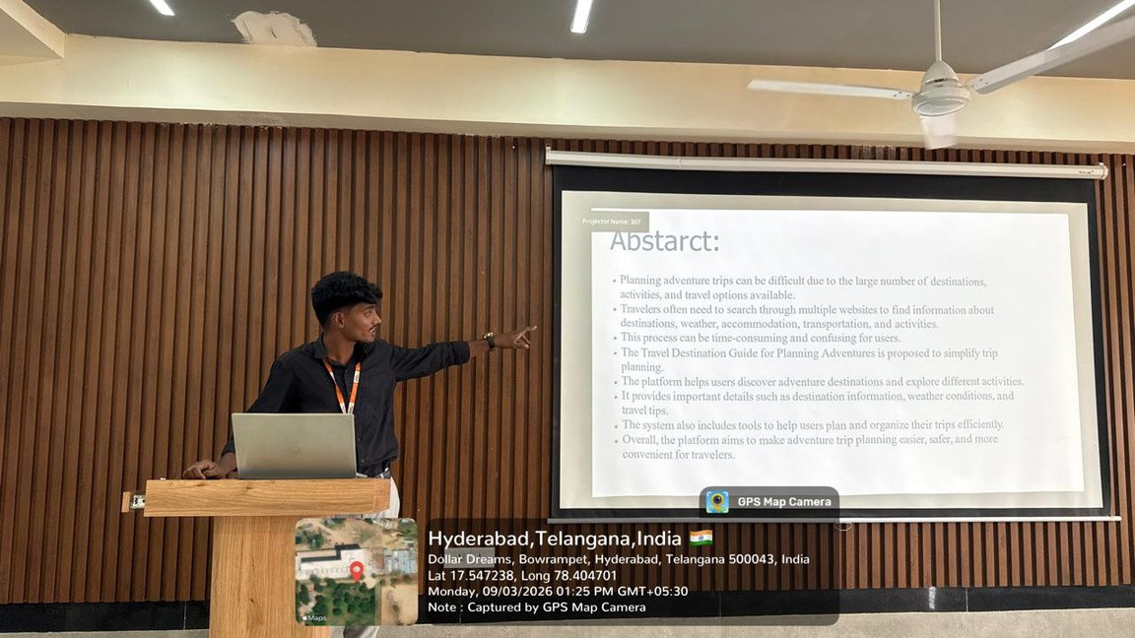
Geo-tag Photos

Slide 14
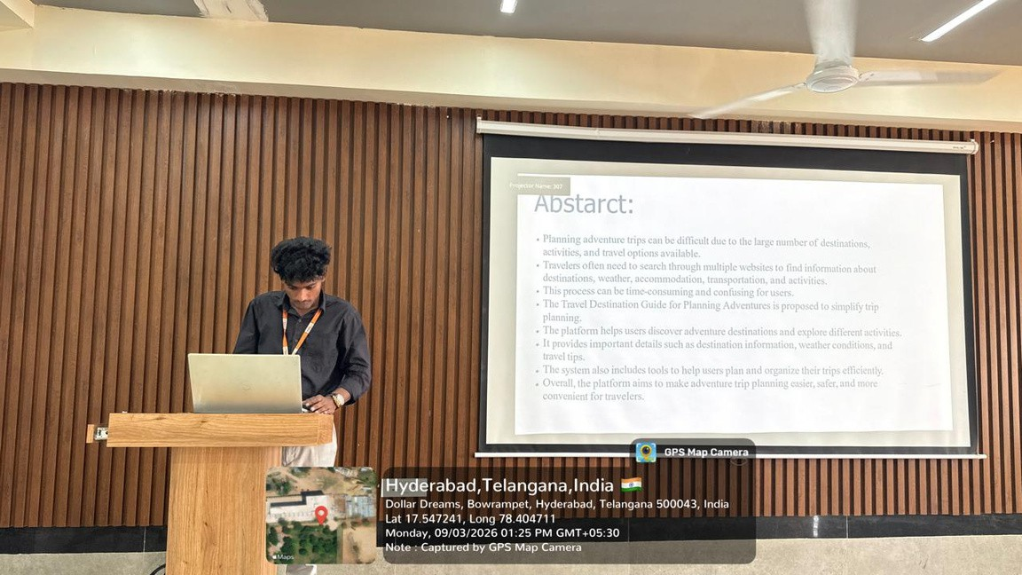
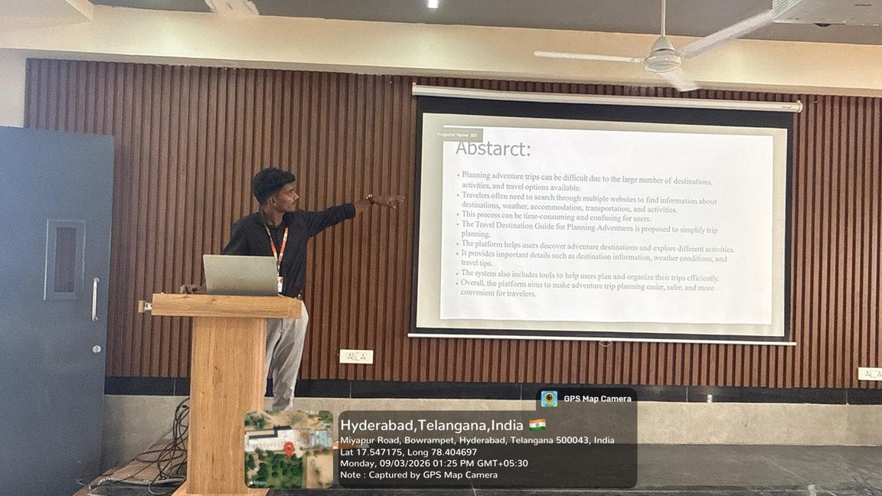

Slide 15
“Make your next adventure unforgettable by embracing new challenges and exploring the beauty of our world.”

Slide 16
Thankyou!

